Slide 1

FOOD DONATION WEBSITE
TEAM MEMBER:-
niKHLESH KUMAR SUBMITTED to:-
Tushar gupta ruchi talwar ma’am
Vishal Upadhyay (technical trainer)
Mayank chandra
Manindra dwivedi

Slide 2
FOOD DONATION PROJECT
Food Donation Project System is a mission to end hunger and no wasting of food to make a hungry-free world. According to the latest survey, 1.3 billion tons of food is thrown as waste every year. Additionally, one-third of the food consumed is stated as leftovers. The focus of this project is to reduce the amount of food wasted and being used to the needy people.
Presently people who wish to donate items need to personally visit the organizations and donate foods or other items. Otherwise, they have to search for some websites to donate surplus food.In general, the large manufacturers, wholesalers, and organized community provide food items to food banks or waste tons of foods daily. They have to search for some organization that needs food.

Slide 3
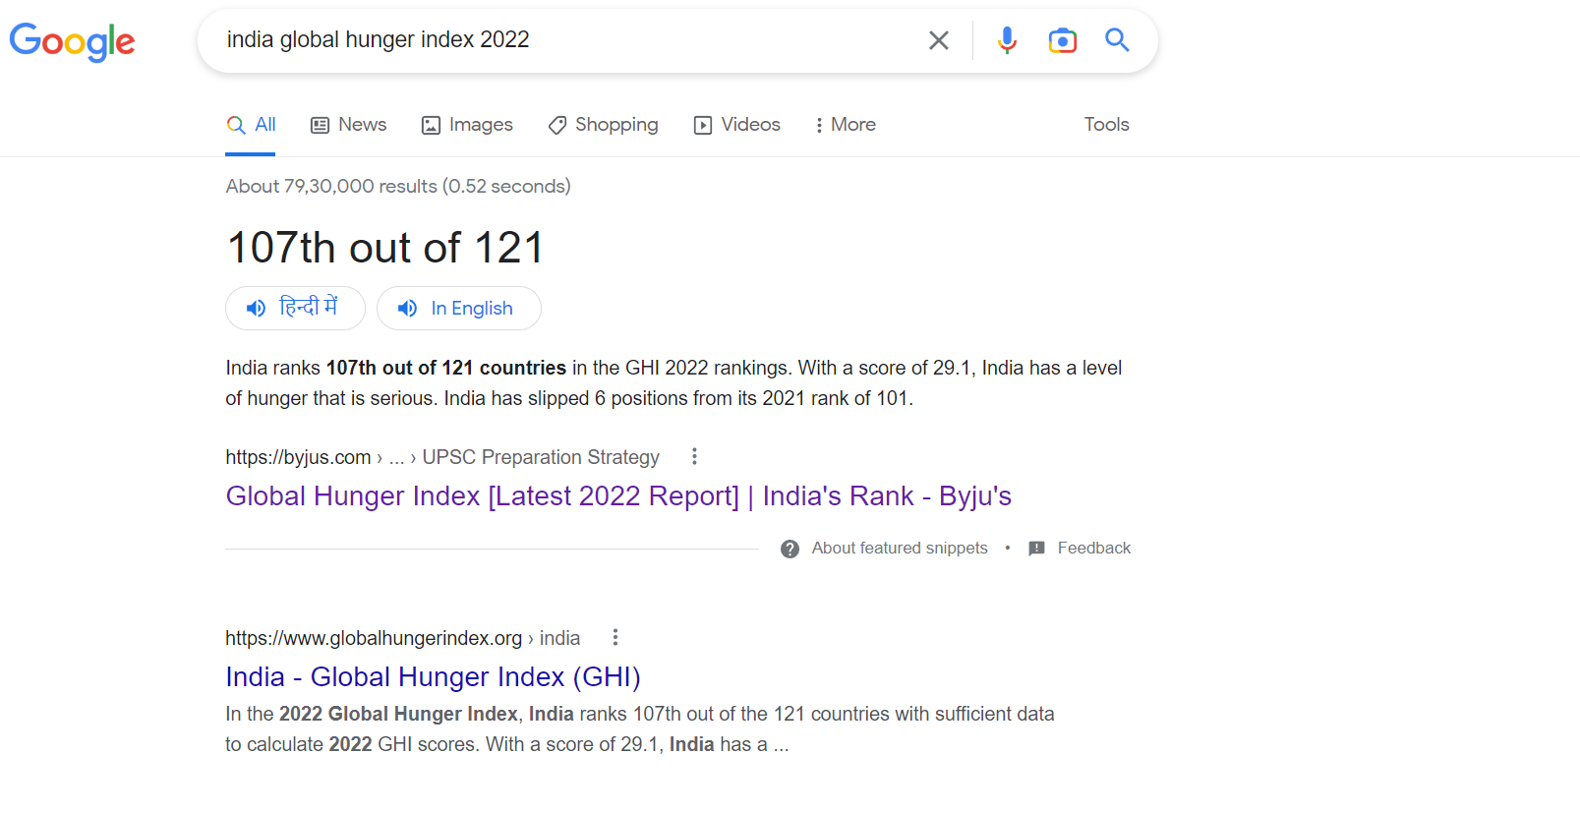

Slide 4
What Is a FOOD DONATION WEBSITE and Why Do WE Need it
India has ranked 107 out of 121 countries in the Global Hunger Index (GHI) 2022. The peer-reviewed annual report, jointly published by Concern Worldwide and Welthungerhilfe, termed the level of hunger in India as ‘serious’ as its GHI score is 29.1. India’s Neighbours performed better in GHI 2022 with Nepal ranked 81, Sri Lanka 64, Bangladesh 84 and Pakistan at 99. In 2021, India secured the 101st position among 116 countries assessed. Important to note, GHI scores are comparable within each year’s report, but not between different years’ reports because of updated data, changing methodology and the number of countries being assessed each year. However, GHI scores of 2000, 2007, 2014, and 2022 are all comparable because they all reflect the revised methodology and the latest revisions of data.

Slide 5
Benefits Food Donations
Easy to Donate Food Directly.
Feed people to feed the economy.
Reduce Food Wastage.
A gift for charity.

Slide 6
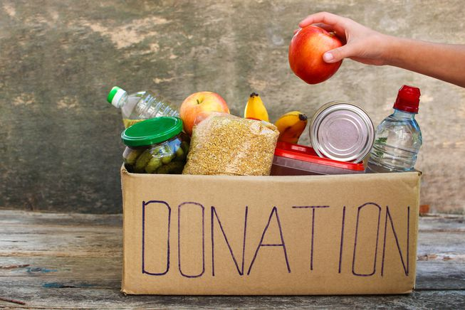
Service our website provide

Slide 7

Clothes Donation

Slide 8
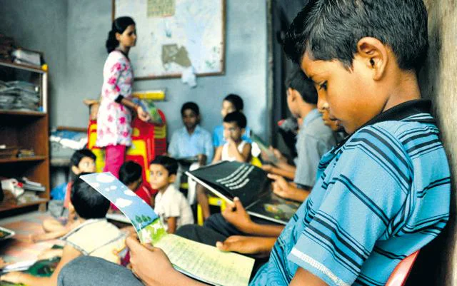
Books Donation

Slide 9
Software and Hardware Use
Window 11
VS Code
HTML, CSS, and JavaScript
MongoDB ,Express
8GB RAM
512 SSD
Google Chrome (To Run our Code)

Slide 10
How its Works
Firstly, Search Food donation.com
Then you create your account on website.
Login your Account
Select the desire donate option
Finally Donate

Slide 11
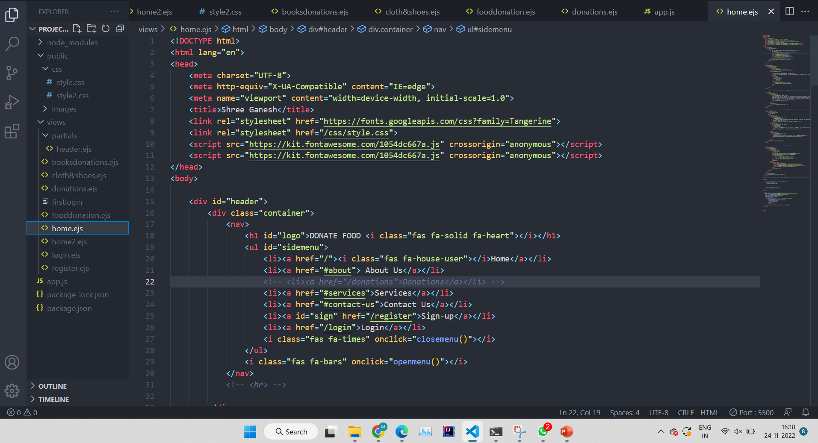
Home Page of our Website Code

Slide 12
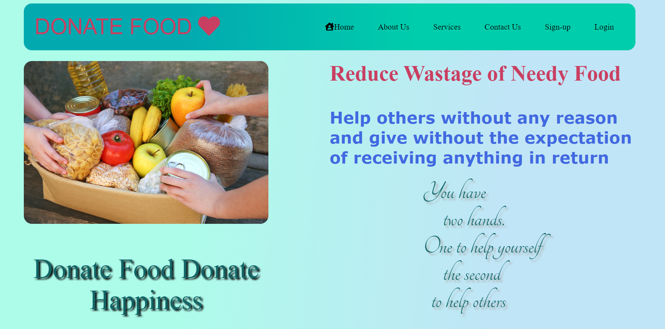
Home Page of Website

Slide 13
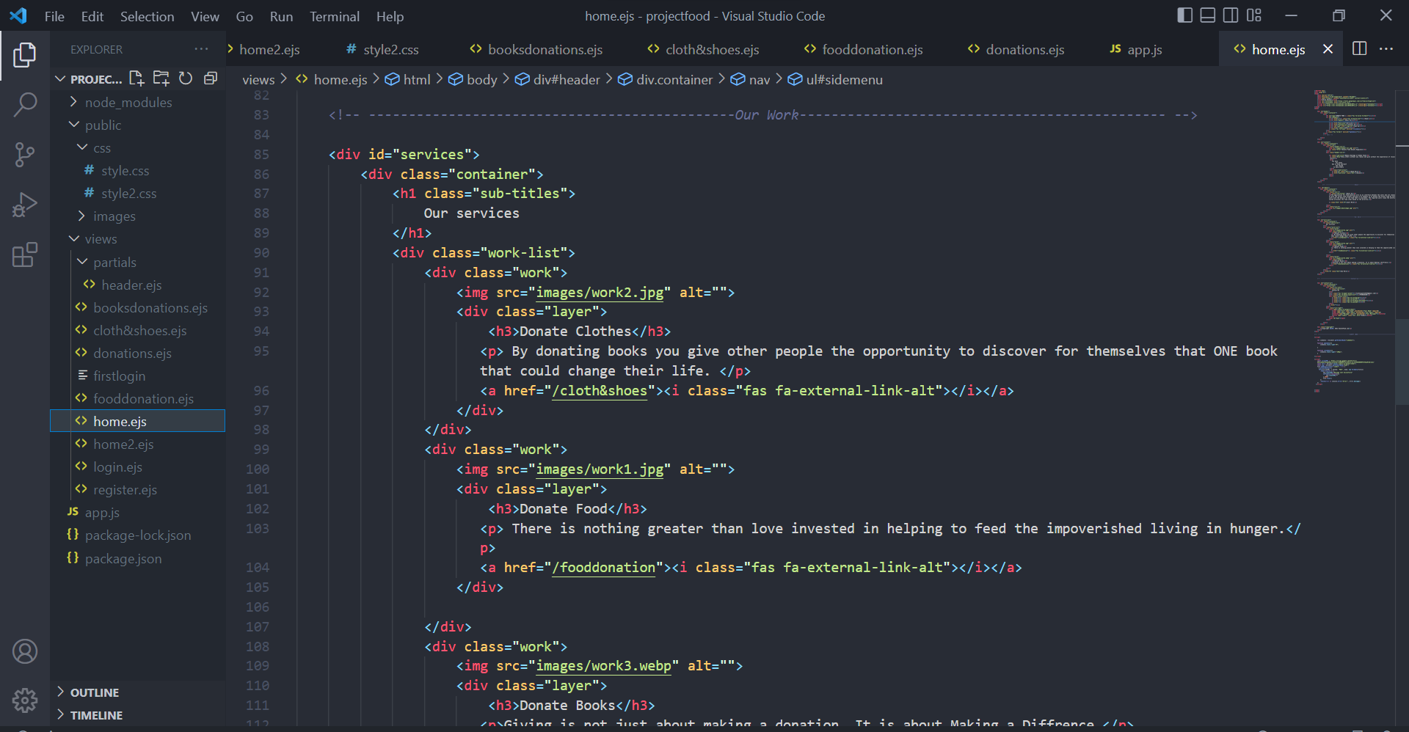
Our Services Code Image

Slide 14
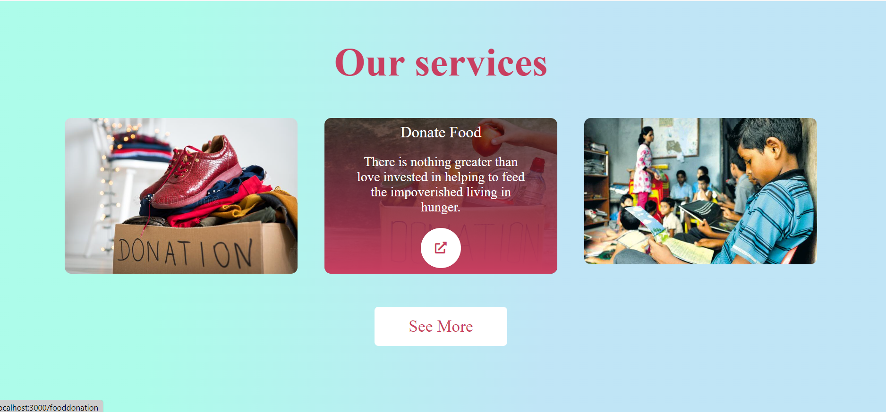
Our Services Image

Slide 15
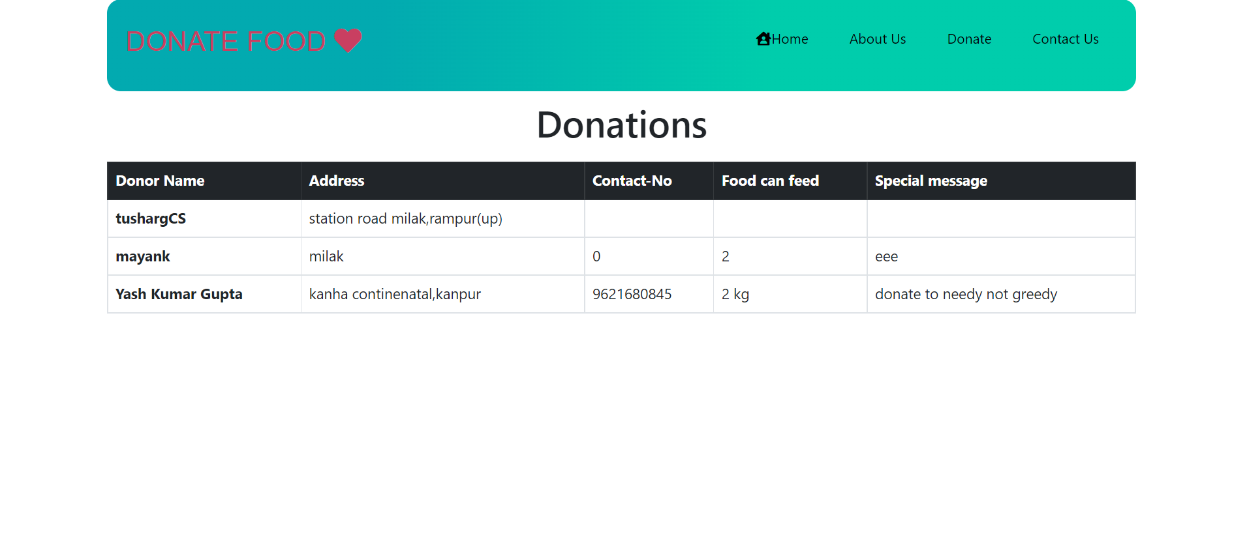
Our Donations

Slide 16
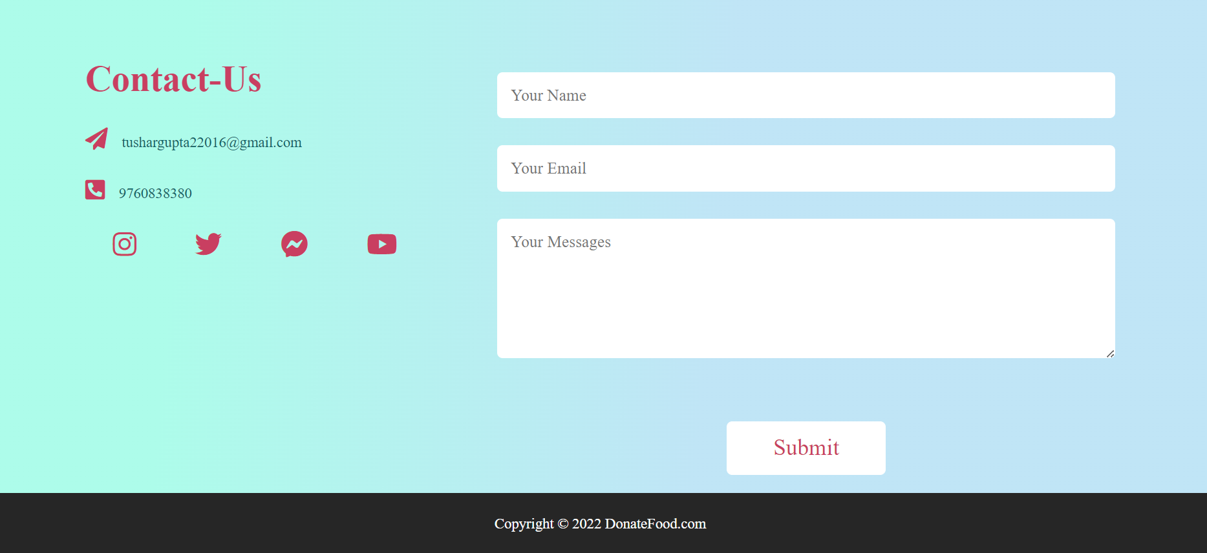
Footer of the Website

Slide 17
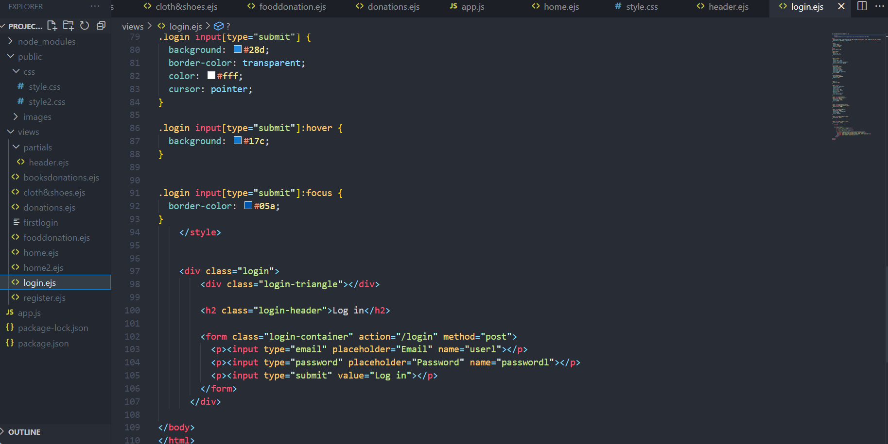
Login Page Code

Slide 18
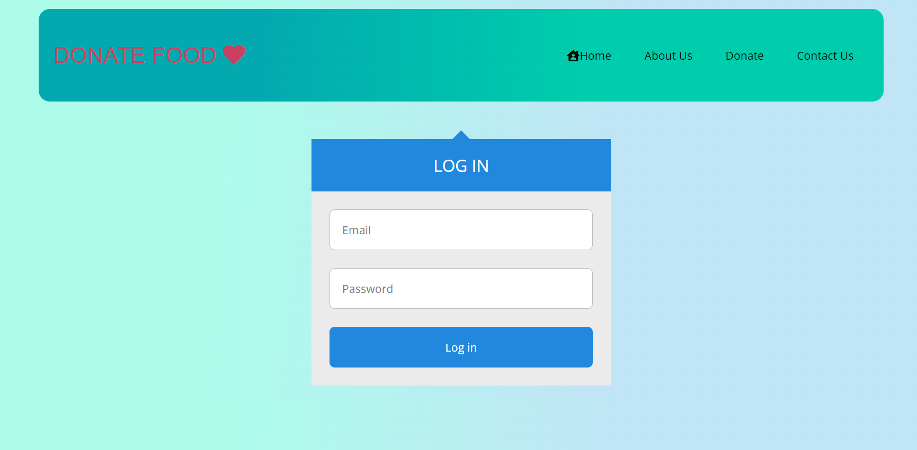
Login Page Image

Slide 19
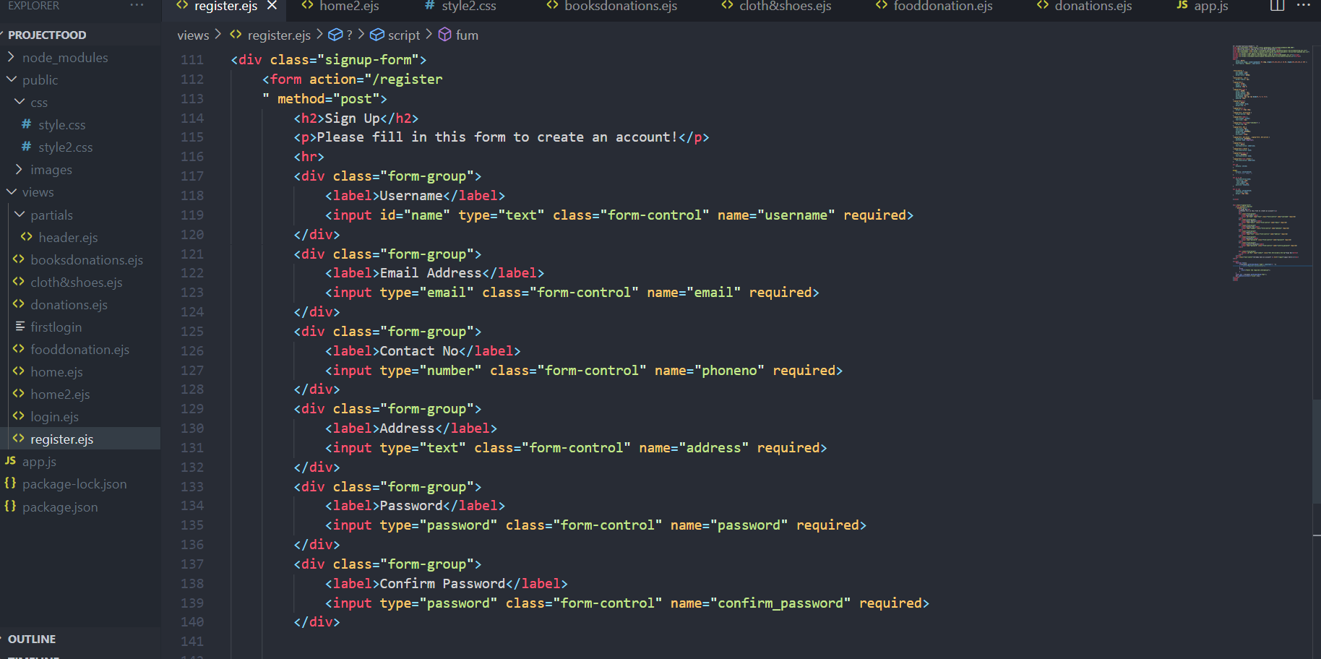
Registration Page Code

Slide 20
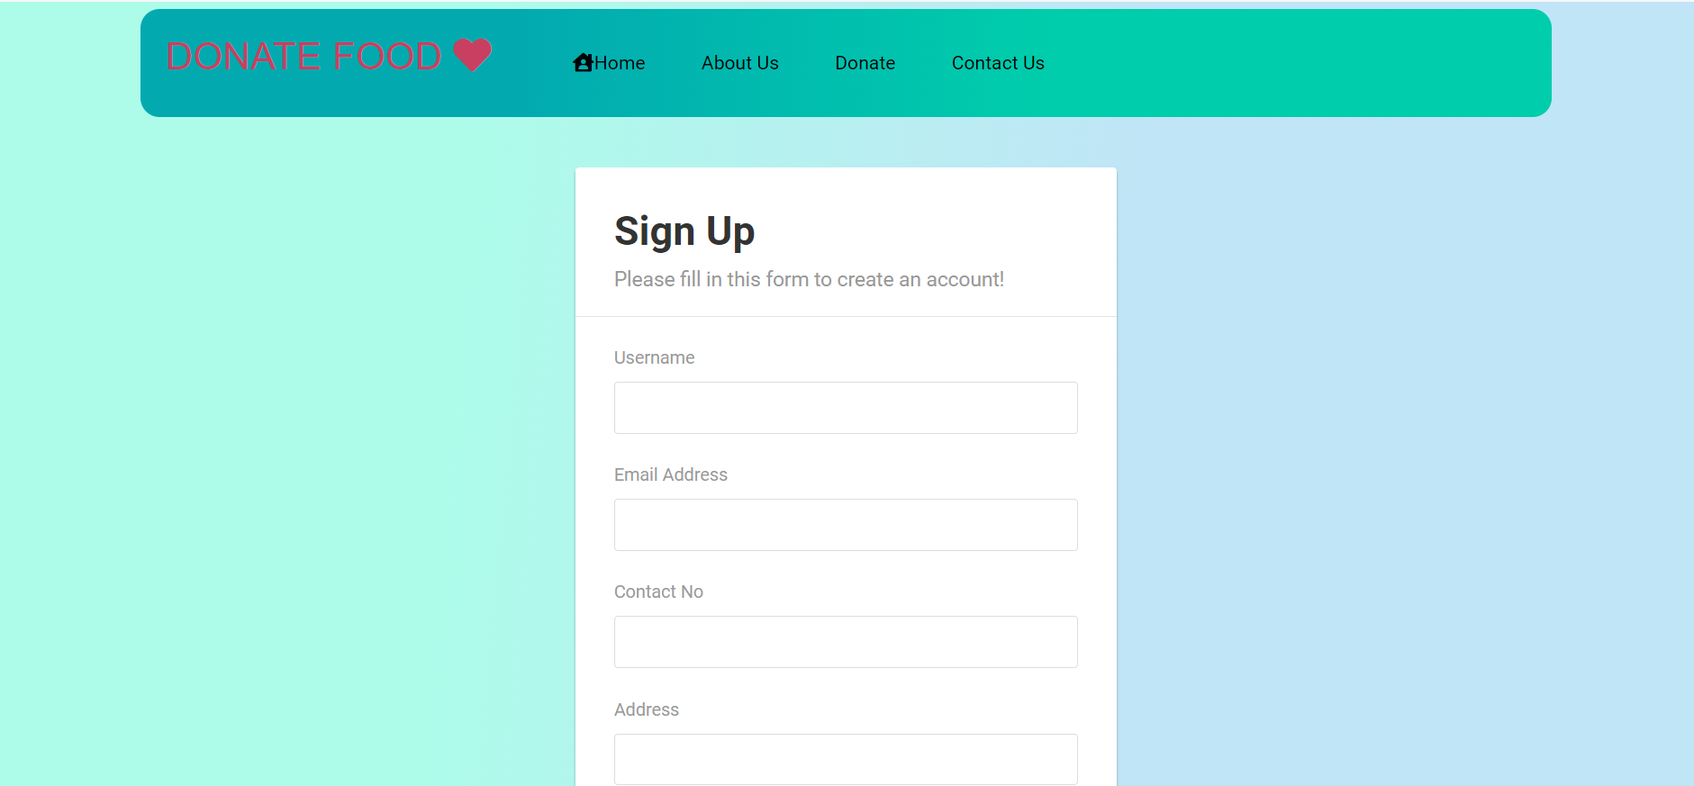
Registration Page Image

Slide 21
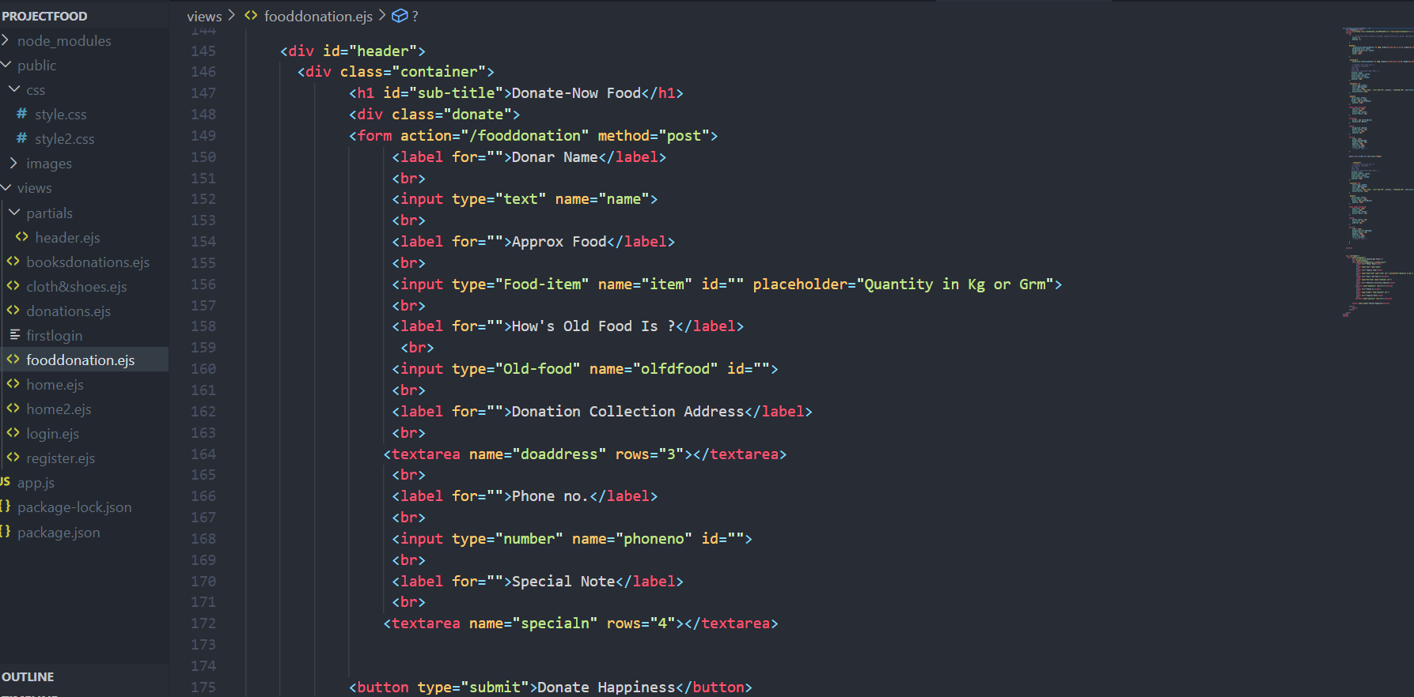
Booking Page Code

Slide 22
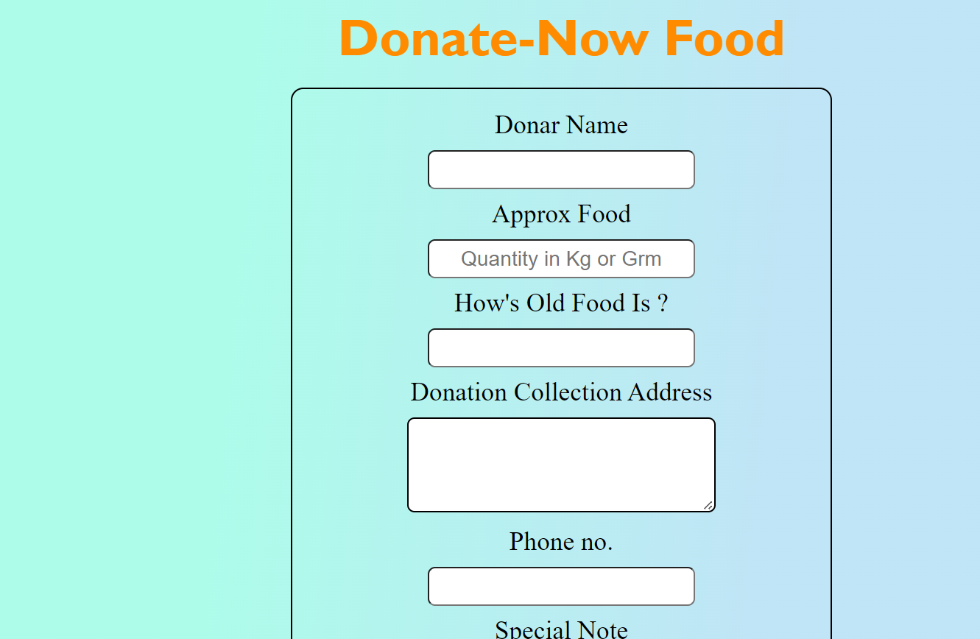
Booking Page Image

Slide 23
THANK YOU

